Slide 1
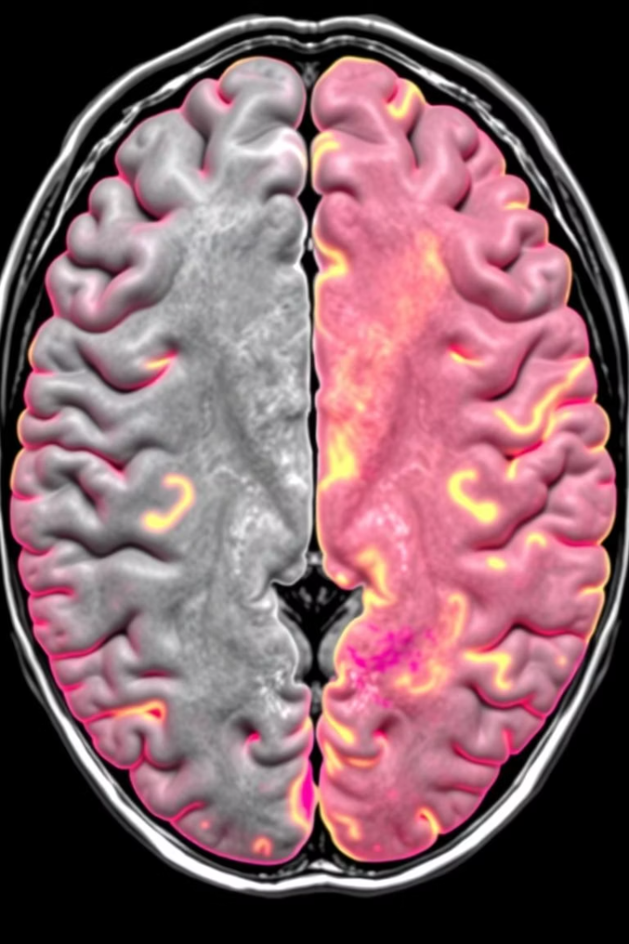
Brain Tumor Segmentation Using Deep Learning (U-Net Architecture)
Submitted by:
Maanya Gupta (E23CSEU0728)
Jashanpreet Kaur (E23CSEU0736)
Sandeep (E23CSEU0850)
Submitted to:
Mr. Nitin Arvind Shelke

Slide 2
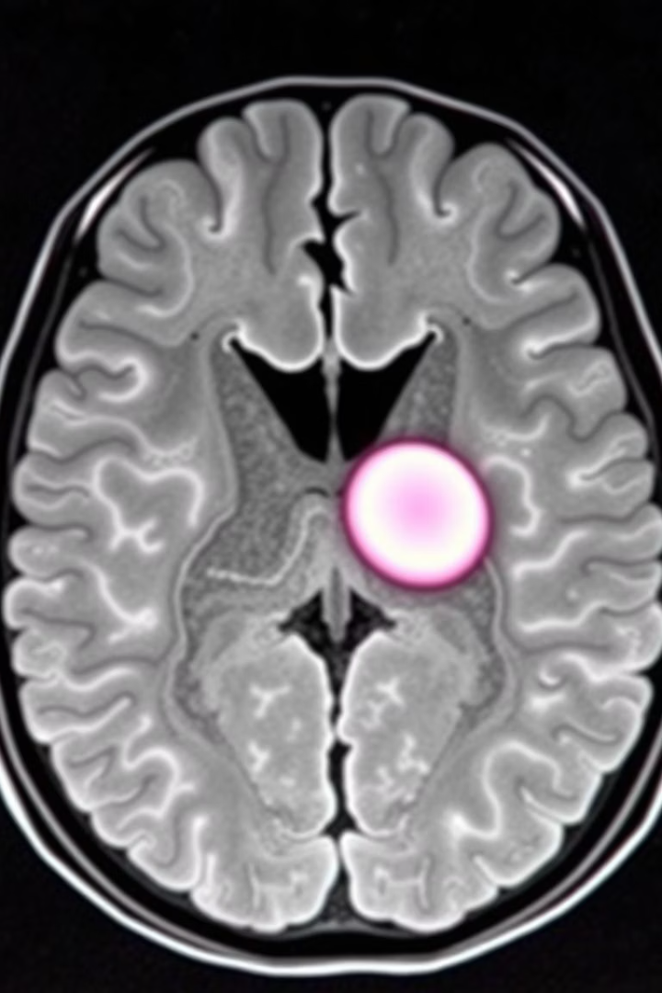
Brain Tumor Segmentation Using Deep Learning (U-Net)
Leveraging U-Net architecture for precise tumor delineation.
Improving diagnostic accuracy and treatment planning.
Deep learning applications in medical imaging: a concise overview.

Slide 3
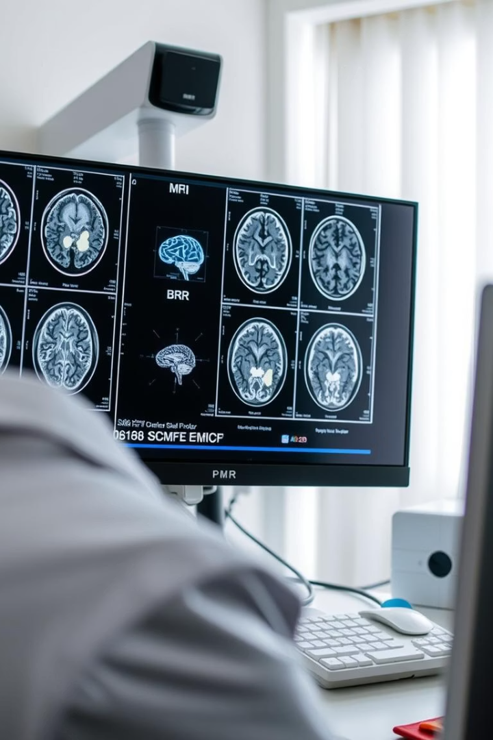
Objective: Accurate Brain Tumor Segmentation
Automation Goal
Model Used
Enhance tumor segmentation from MRI scans automatically.
Use U-Net model for precise pixel-level tumor identification.
Clinical Impact
Reduce human error and time required for manual segmentation.

Slide 4
Problem Domain: Challenges in Medical Imaging
High Variability
Data Limitations
Need for Precision
Example
Tumor size, shape, and location vary widely across patients.
Few annotated medical images available for training deep models.
Good accuracy required for clinical-grade segmentation.
Gliomas often have irregular, fuzzy tumor boundaries.

Slide 5
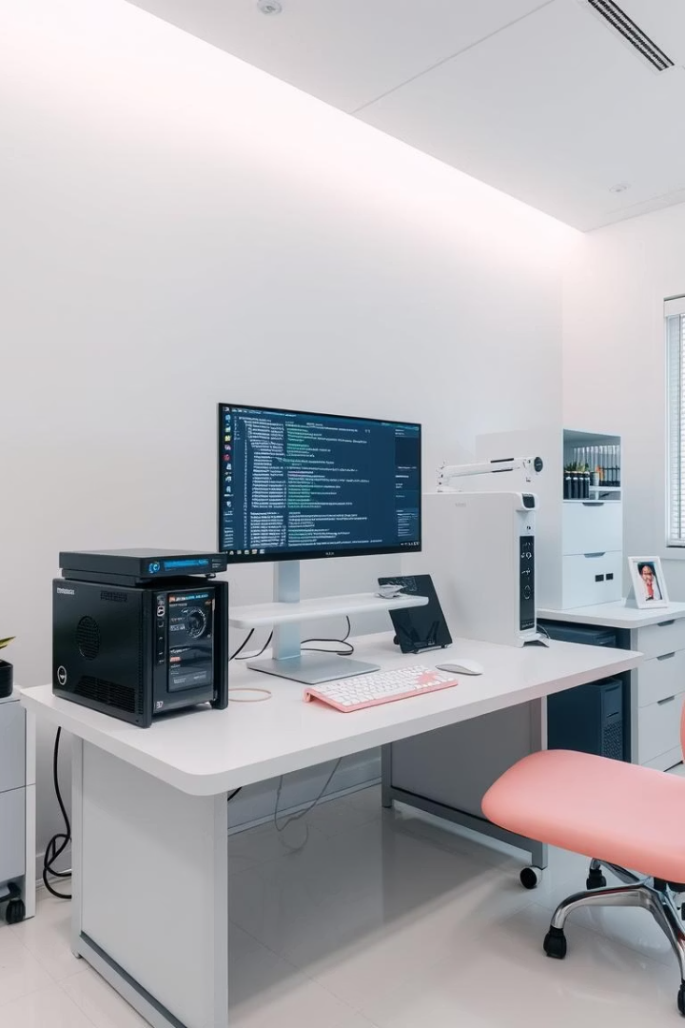
Tools & Libraries Used
Data Handling: numpy, pandas
Visualization: matplotlib, seaborn
Image Processing: OpenCV, scikit-image
Machine Learning: scikit-learn
Deep Learning: TensorFlow, Keras

Slide 6
Dataset Description:
Source: Kaggle - LGG MRI Segmentation
MRI scans and corresponding masks.
Dataset split:
Training: 80%
Validation: 10%
Testing: 10%

Slide 7
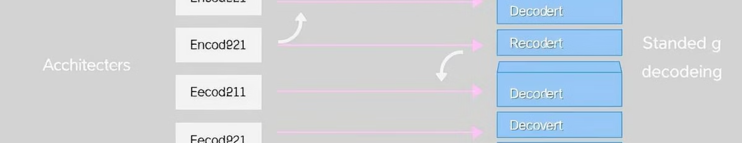




U-Net Architecture for Segmentation
Encoder Path
Decoder Path
Skip Connections
Modifications
Downsamples input, captures context features
Upsamples and recovers spatial details
Preserve fine details by concatenating features
Residual blocks and attention gates for accuracy

Slide 8
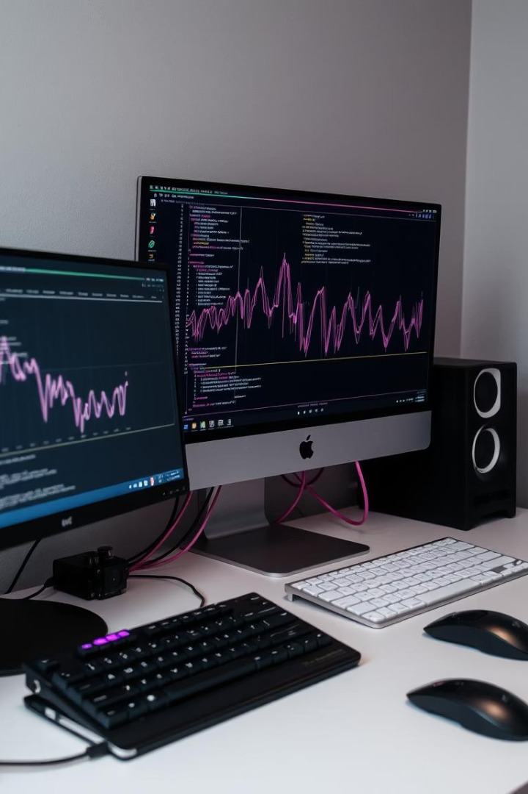
Training the U-Net Model
1
Loss Functions
Binary Cross entropy
2
Optimizer
Adam
3
Techniques
Batch Normalization, and Data Augmentation
4
Training
120 epochs, batch size 40

Slide 9
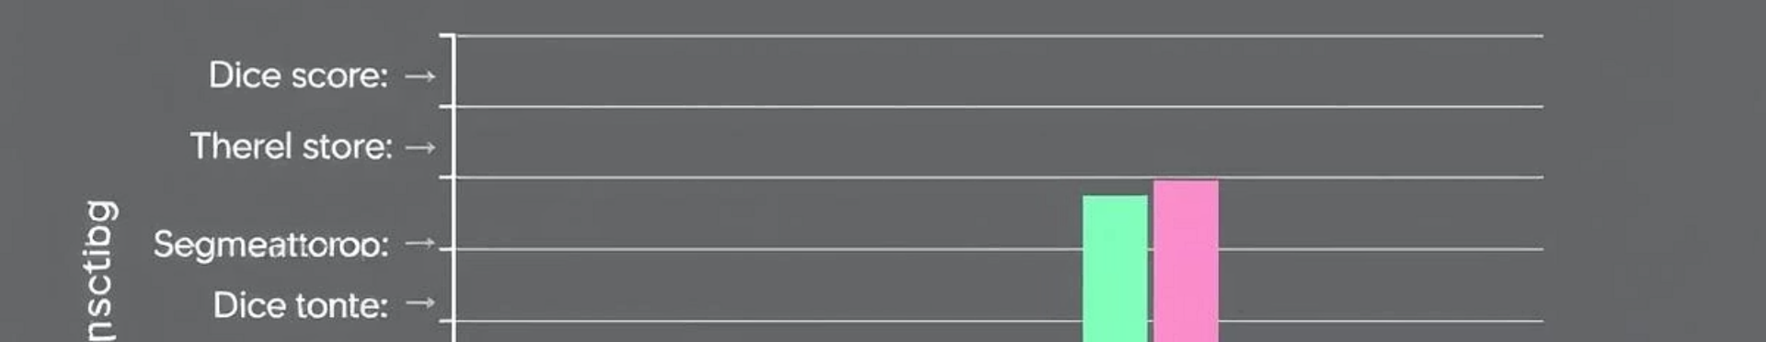
Evaluation Metrics
ACCURACY:
Correct pixel prediction rate.
IoU (Intersection over Union):
Overlap of predicted and true mask.
Dice Coefficient:
2 x (Intersection) / (Predicted + Actual)

Slide 10
Result Visualization and Analysis
Compare:
Original MRI Image
Ground Truth Mask
Predicted Mask

Slide 11
Conclusion:
U-Net is effective for brain tumor segmentation.
Provides high accuracy in identifying tumor structures.
Supports medical imaging workflow with automation.

